Slide 1
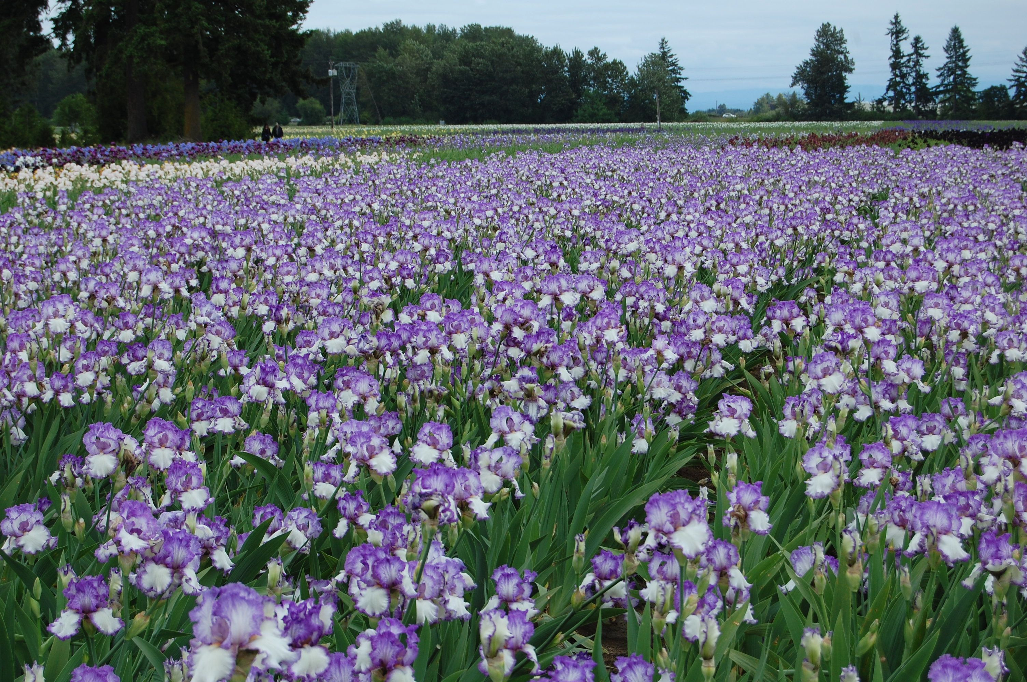
Iris Dataset Classification
Ronan Underwood

Slide 2
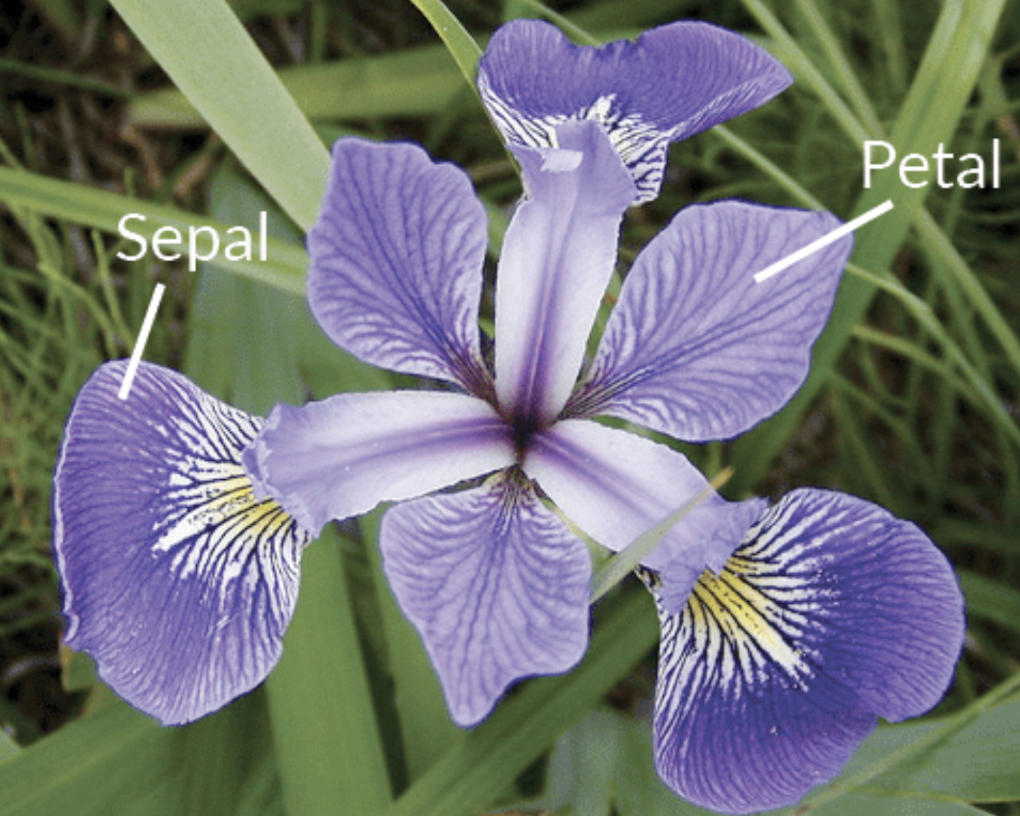
Iris Dataset
3 classes
50 points / class
Features:
Sepal length & width
Petal length & width

Slide 3
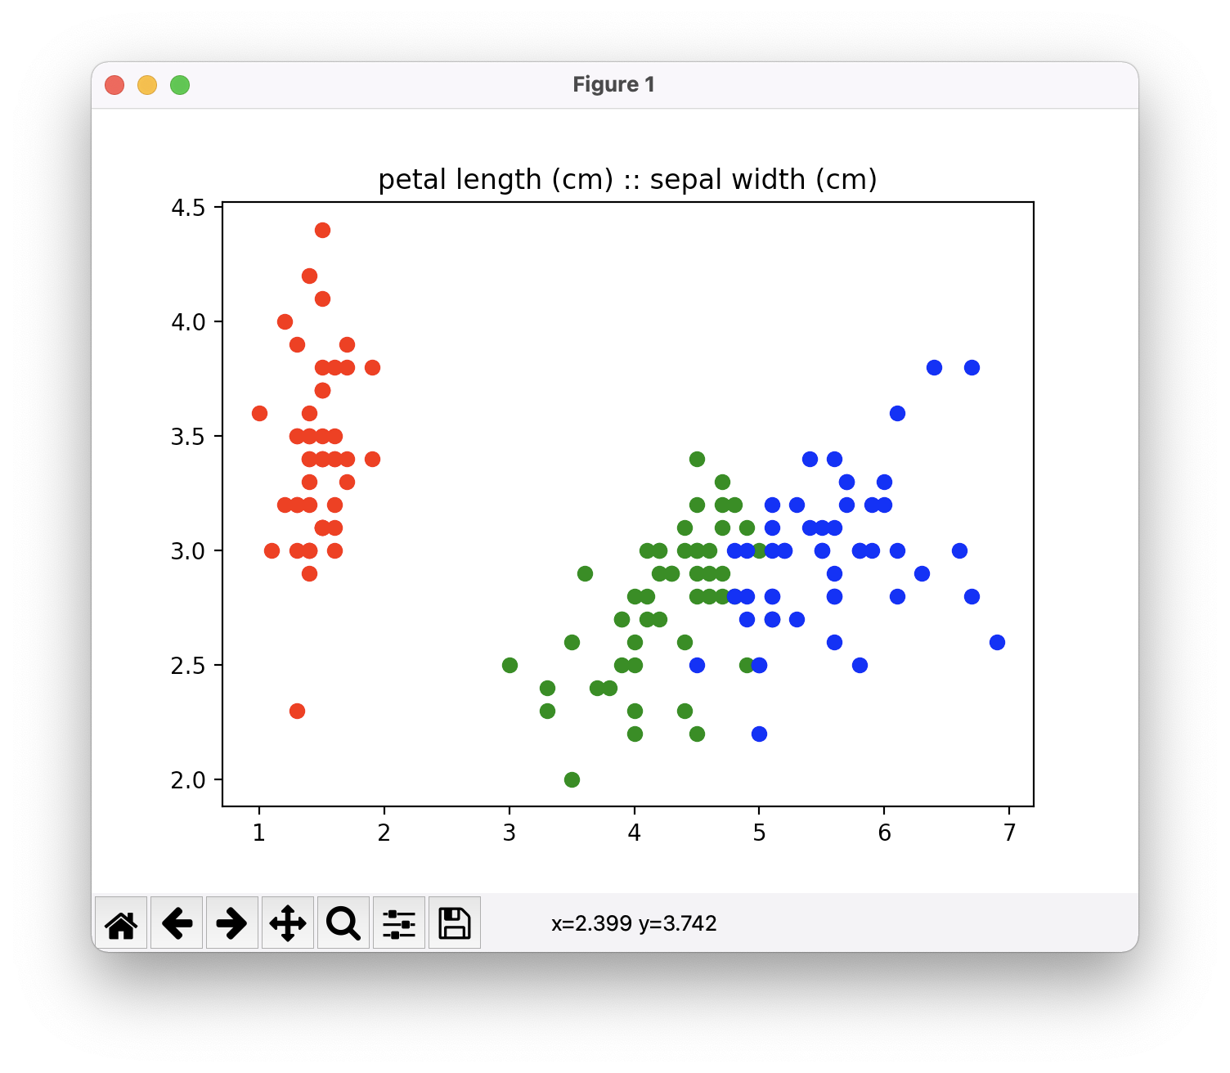
Goal: Categorize the iris dataset with artificial intelligence

Slide 4
Agenda
- Explore the data
- Prepare the data
- Pick a model
- Linear
- Logistic

Slide 5
Data Exploration

Slide 6
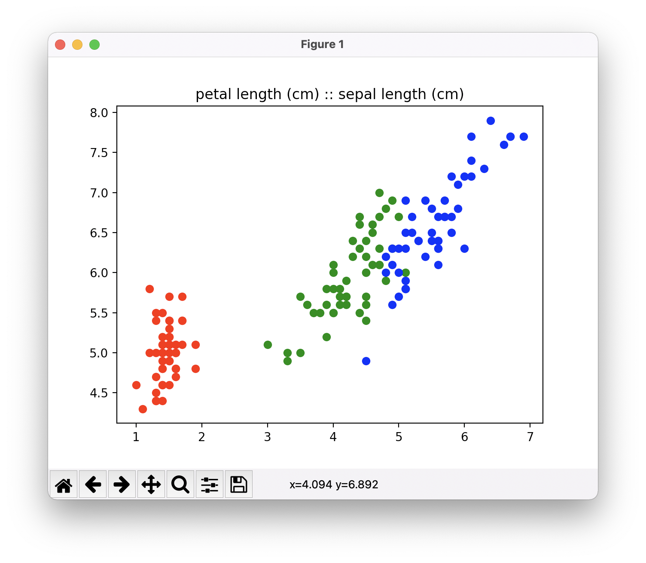
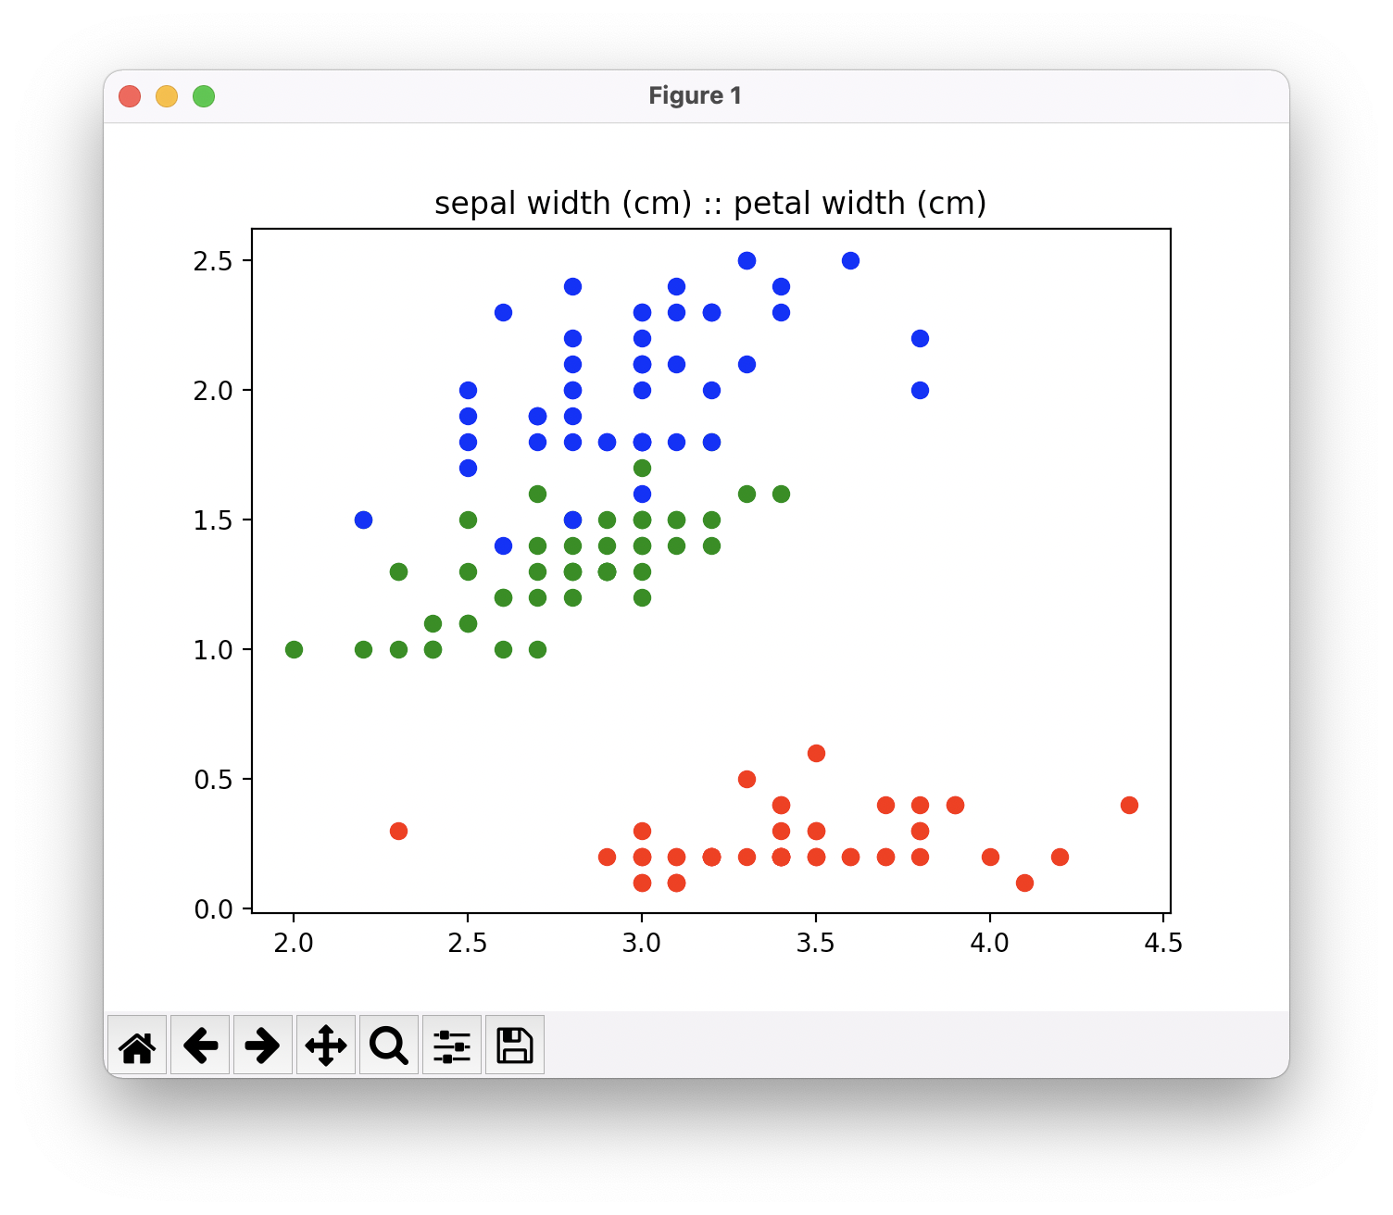
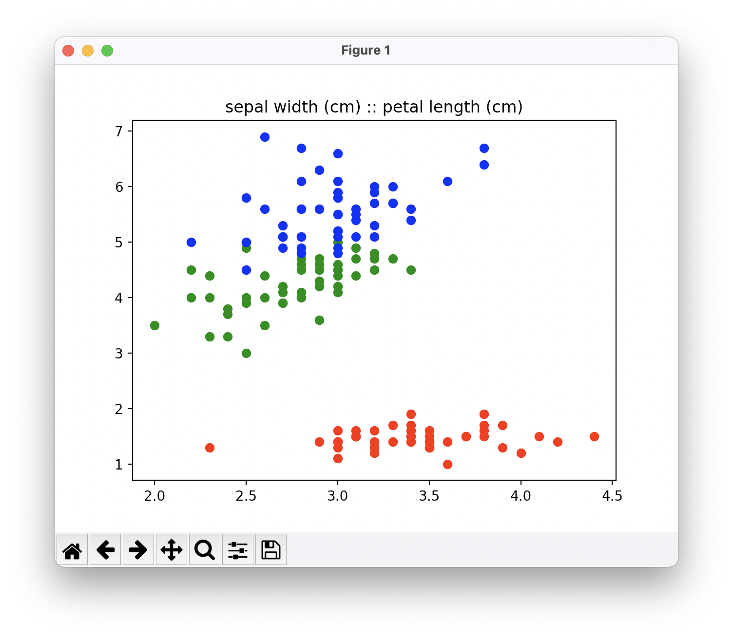
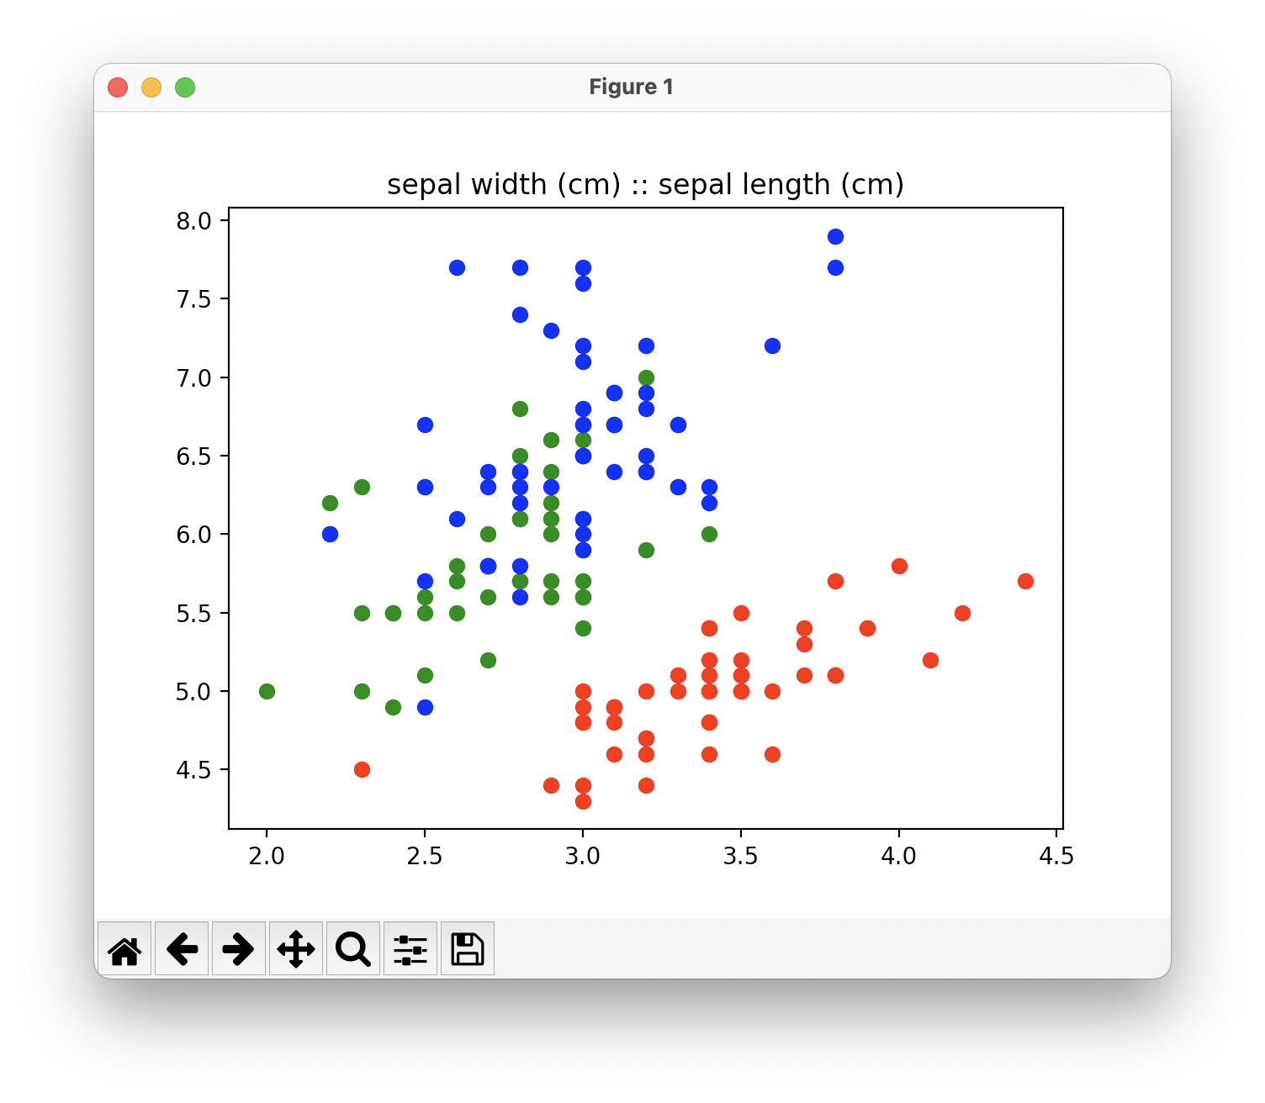
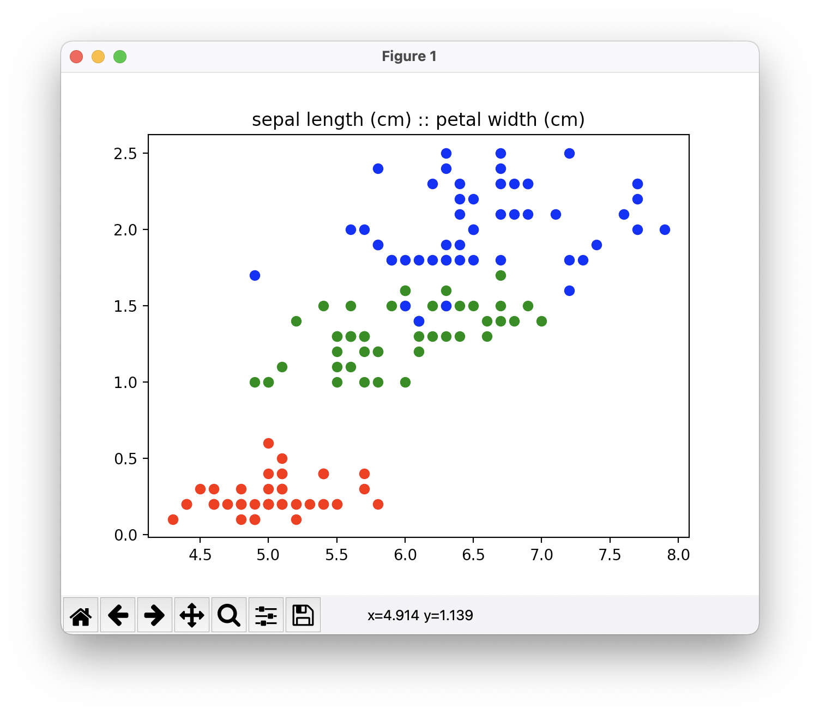
Data Exploration..

Slide 7
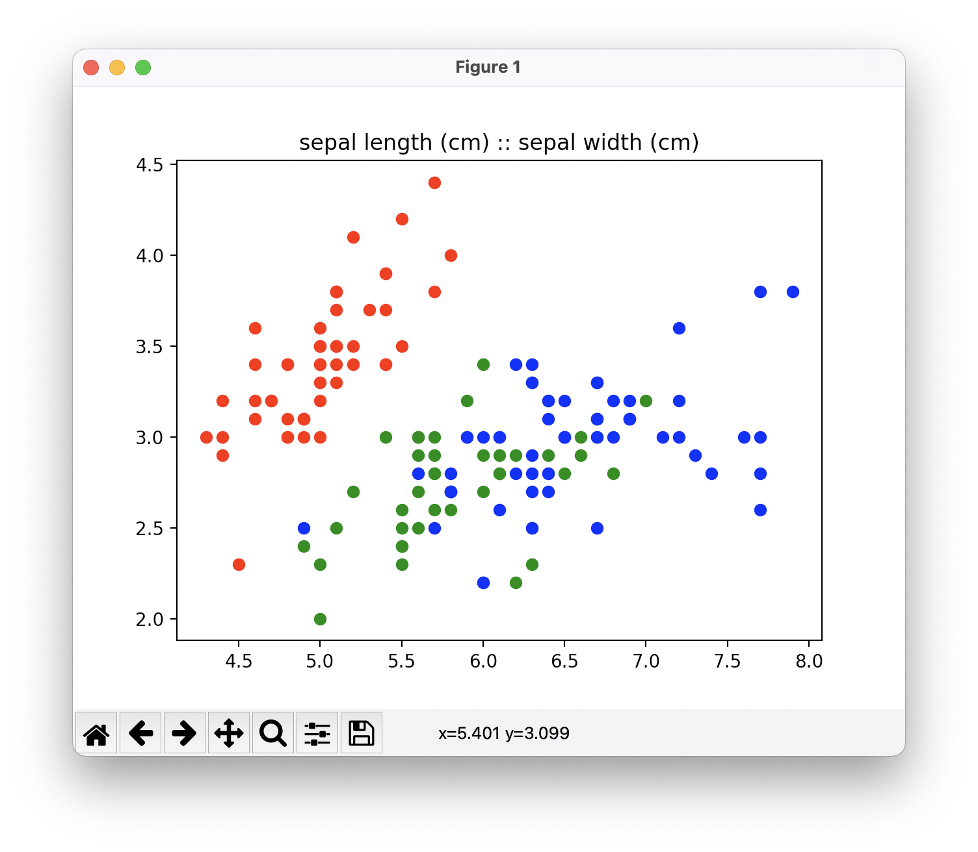
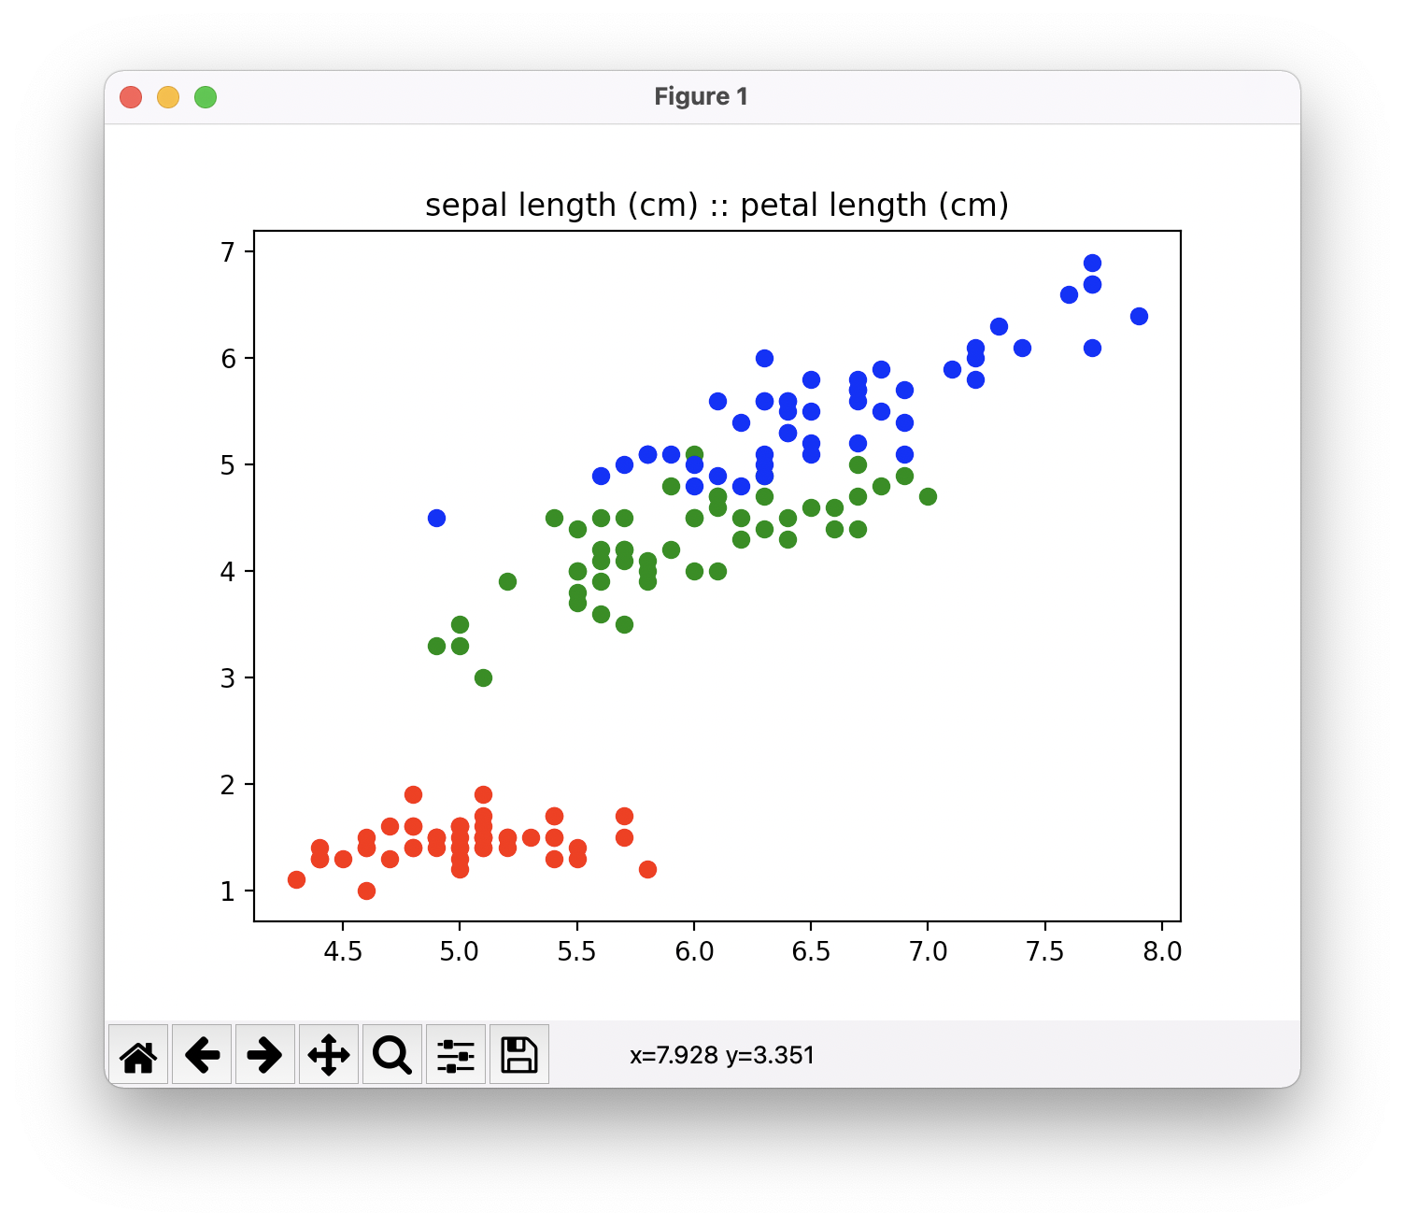
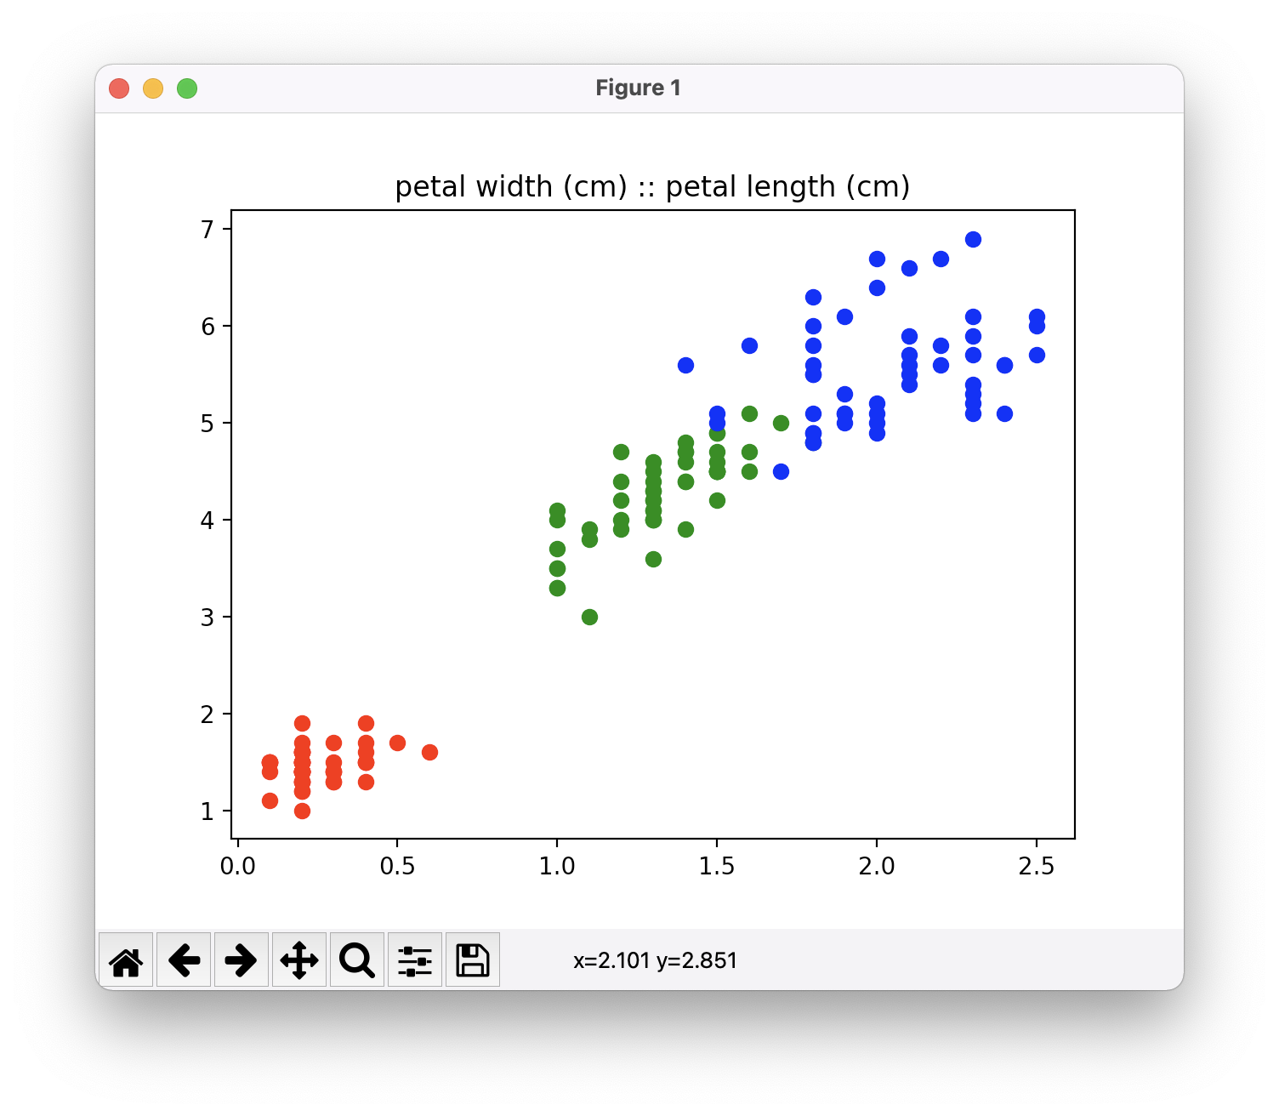
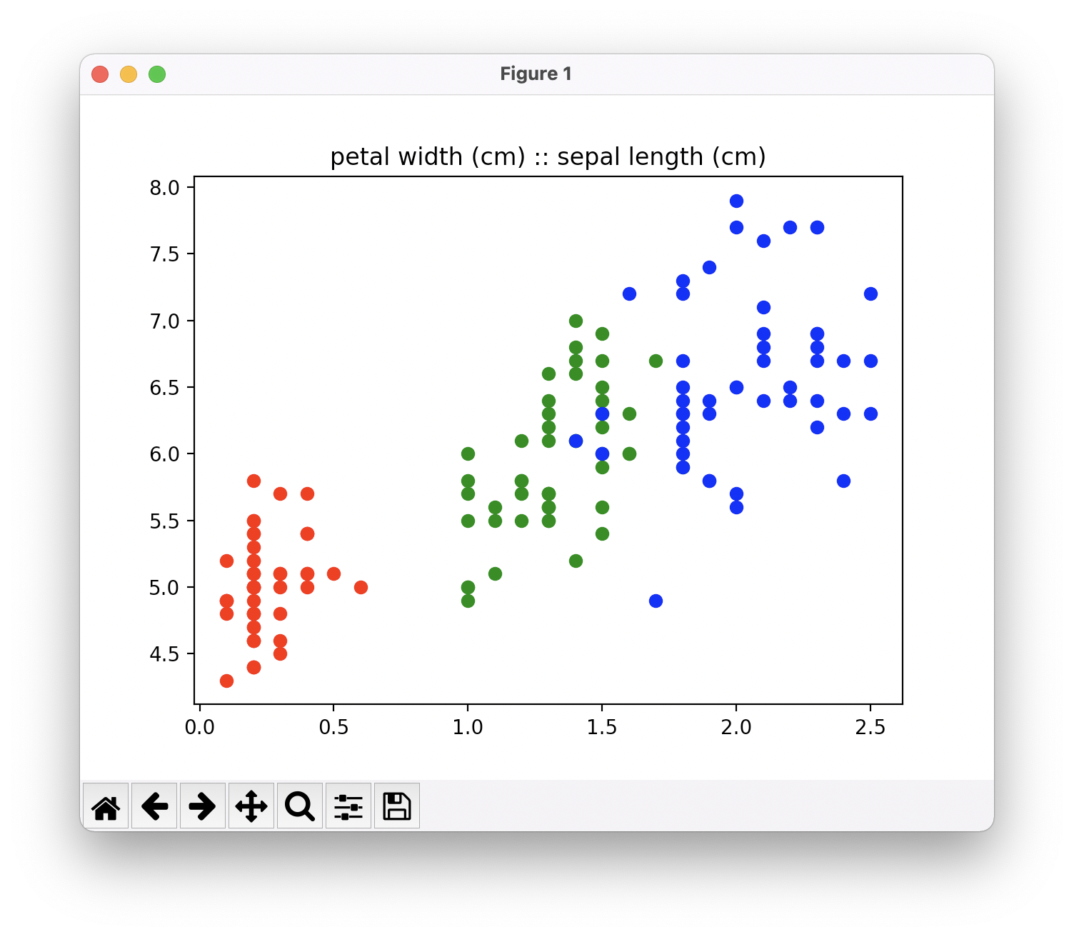
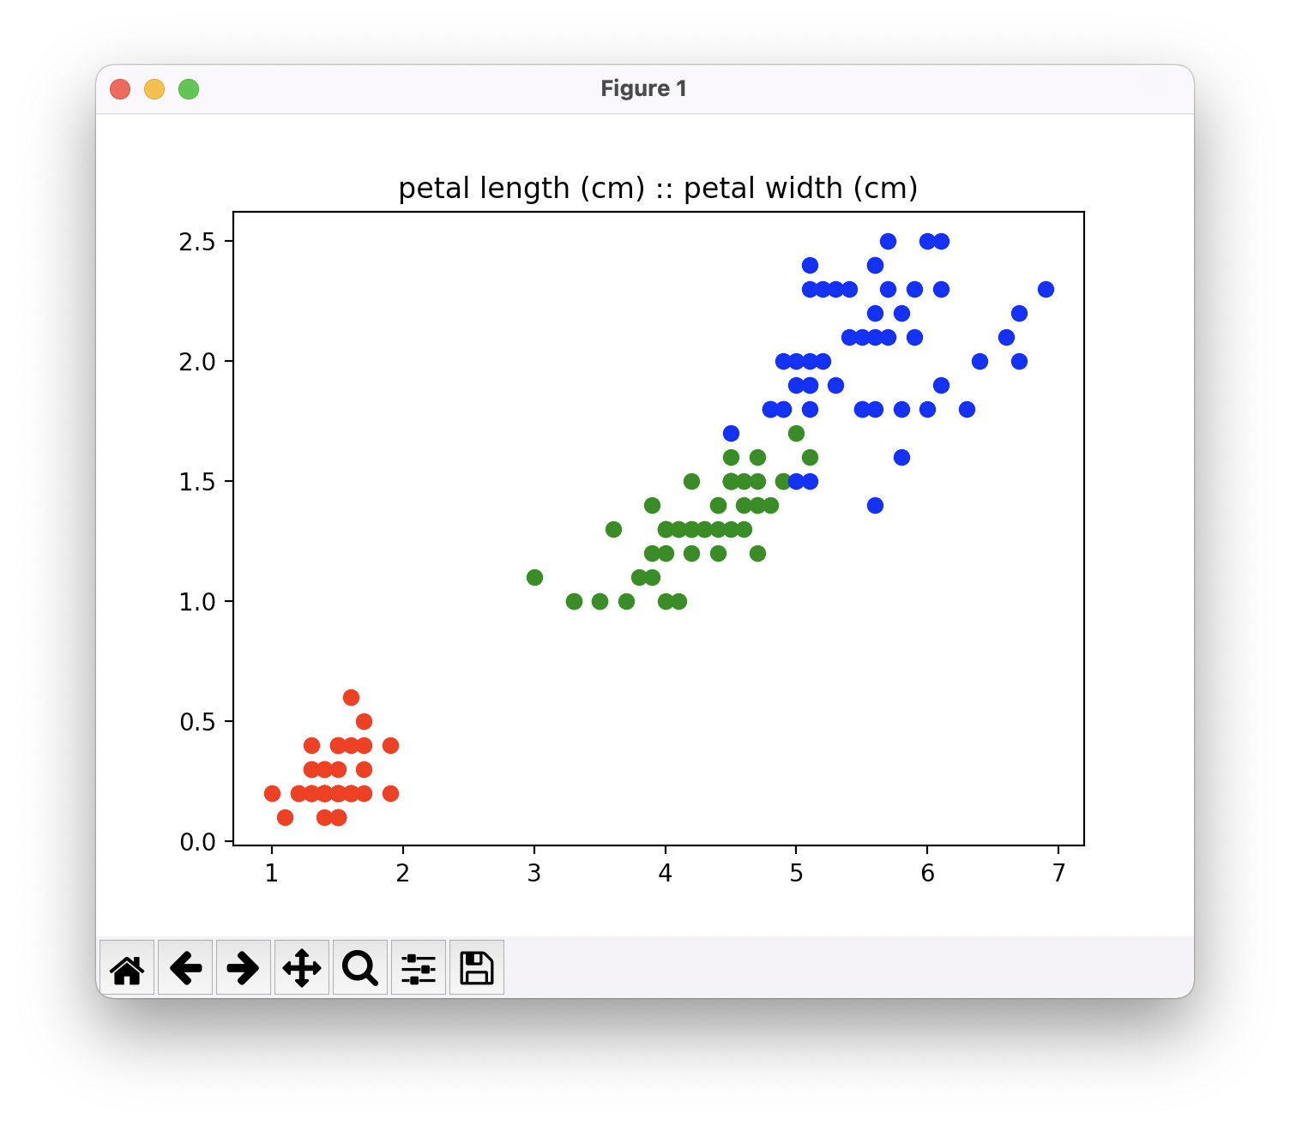
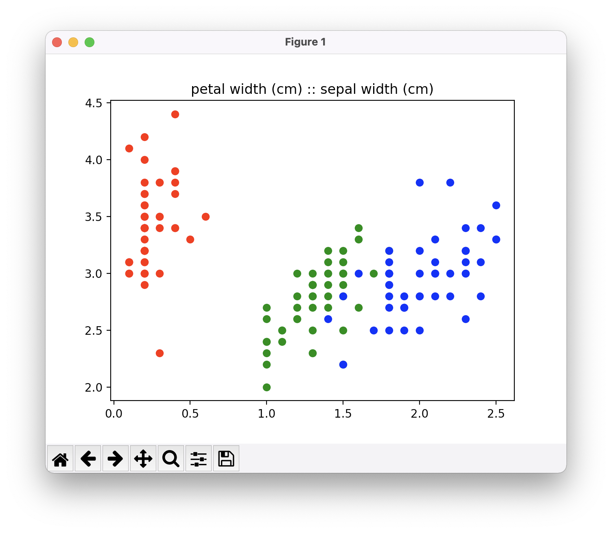
Data Exploration..

Slide 8
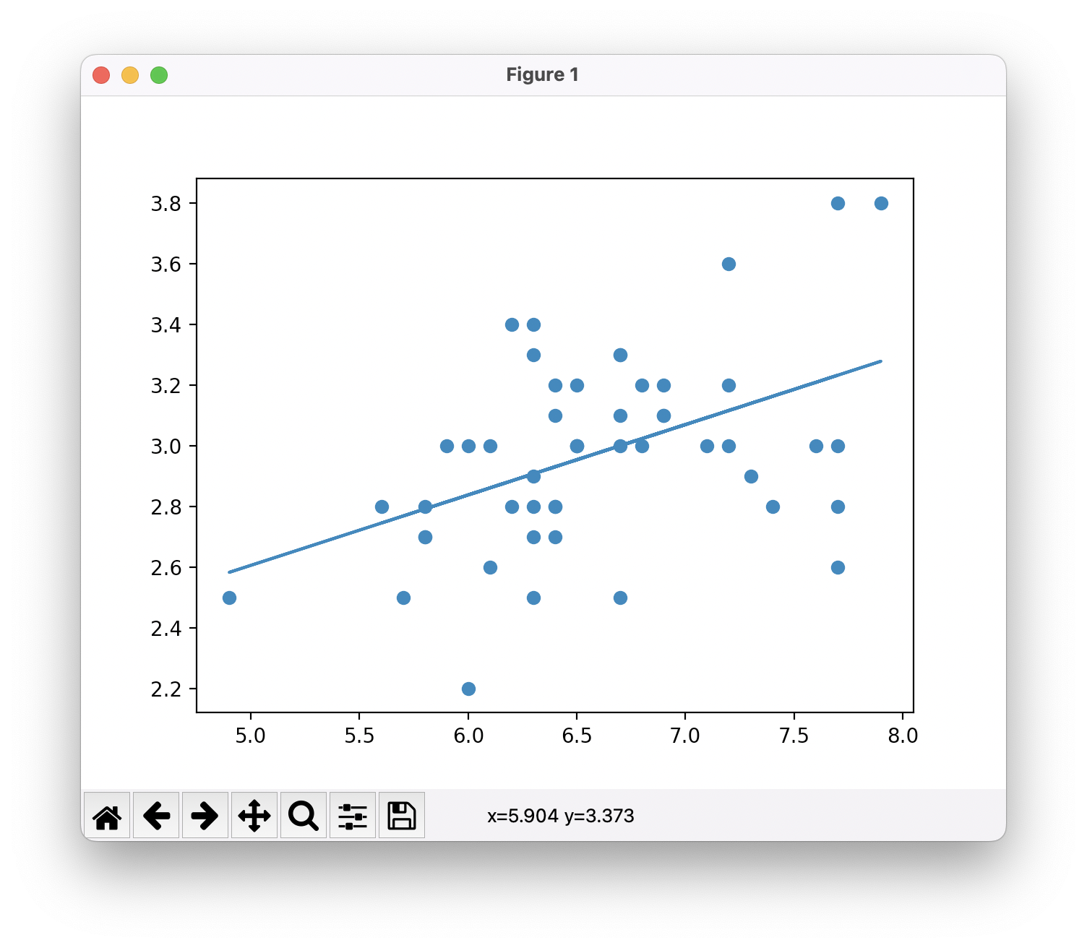
Linear Regression
A method of predicting trends by graphing them
Great for finding general trends

Slide 9
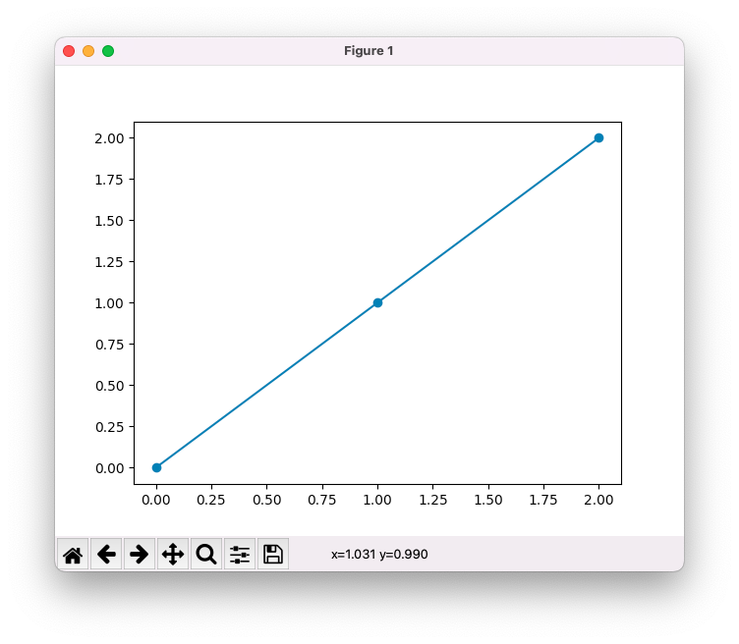
Dummy Dataset
Linear Regression
Dummy Dataset
Logistic Regression

